Slide 1

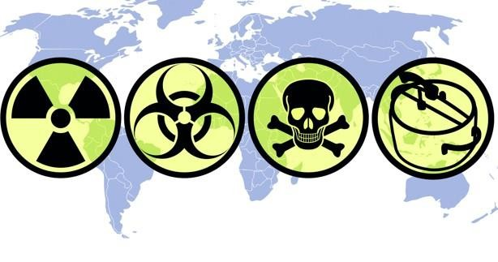
COMPLIANCE AML/CFT TRAINING FOR ALL EMPLOYEES
APRIL 2026

Slide 2
TRAINING OBJECTIVES
Understand AML/CFT regulations and their importance.
Learn your roles and responsibilities in preventing ML/TF.
Identify red flags in transactions and customers.
Strengthen a compliance culture across the institution.

Slide 3
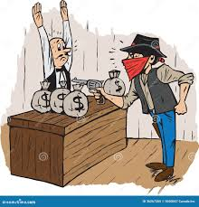

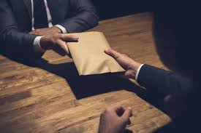


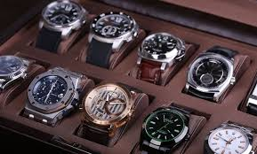
MONEY LAUNDERING
Money laundering is the process of disguising funds obtained from criminal activities so they appear legitimate. It is a secondary offence, meaning it only occurs after a predicate offence (the original crime that generated the illicit funds).
In the context of an IMTO like Olive Monies, the original crime may happen elsewhere (e.g., overseas cybercrime), but the proceeds can pass through your remittance platform. Even if your institution was not involved in the initial crime, processing such funds—knowingly or through weak controls—can expose the company to money laundering risks.
This is why AML controls focus on identifying unusual or suspicious transactions, as you are more likely to encounter the movement of illicit funds rather than the original criminal activity.

Slide 4
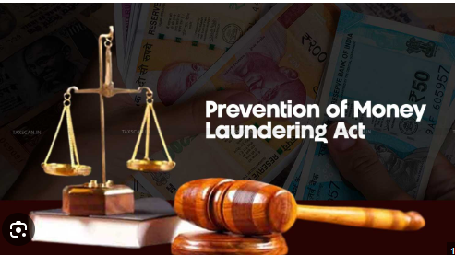
SOURCES OF MONEY LAUNDERING (PREDICATE OFFENCES) (Based on Money Laundering (Prevention and Prohibition) Act 2022)
Money laundering funds usually come from serious crimes such as:
Financial crimes: Fraud, bribery, corruption, counterfeiting
Cyber & organized crime: Scams, racketeering, terrorist financing
Drug & human trafficking: Narcotics trade, human smuggling, exploitation
Violent crimes: Kidnapping, robbery, theft
Smuggling & tax crimes: Illegal goods, tax evasion
Market abuse: Insider trading, manipulation

Slide 5
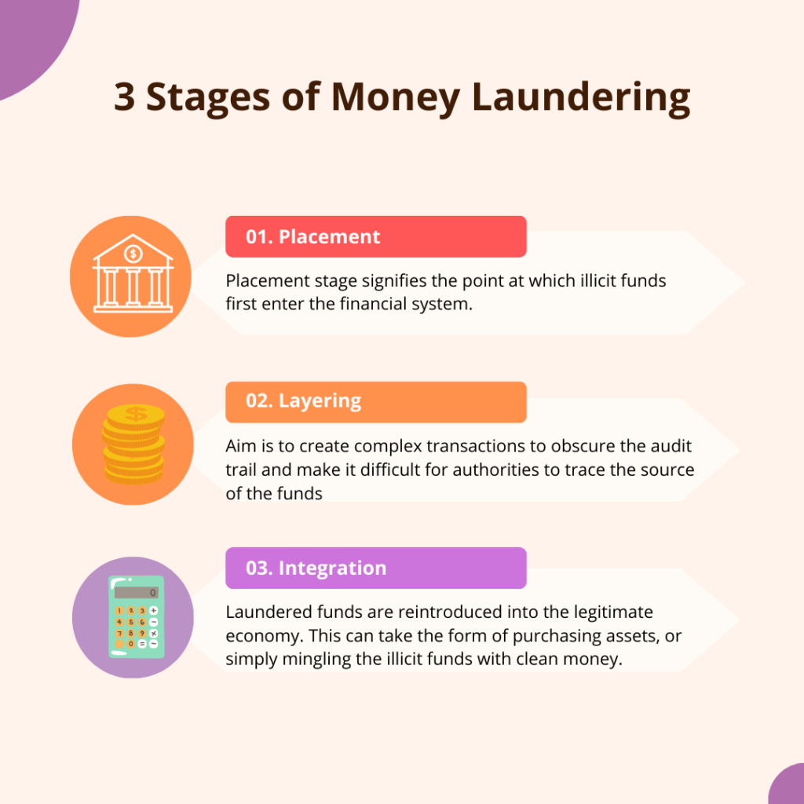
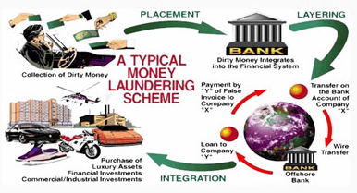
STAGES OF MONEY LAUNDERING
06

Slide 6
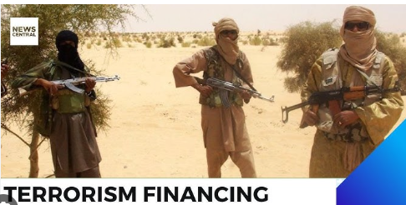
TERRORIST FINANCING (CFT) (In line with Central Bank of Nigeria AML/CFT Regulations)
What is Terrorist Financing? The provision, collection, or movement of funds to support terrorist acts or organisations — whether the funds are legal or illegal.
Key Regulatory Guidance (CBN):
Financial institutions must identify, monitor, and report suspicious transactions linked to terrorism
Mandatory screening against sanctions lists (e.g., UN, domestic lists)
Immediate reporting of suspicious activities to the Nigerian Financial Intelligence Unit
Strict prohibition of dealing with designated individuals or entities
Common Red Flags:
Transfers to/from high-risk or sanctioned locations
Multiple small transactions structured to avoid detection
Use of third parties with no clear relationship
Transactions with no clear economic purpose
Your Responsibility:
Always follow KYC and screening procedures
Do NOT process suspicious transactions
Escalate immediately to Compliance
Never inform the customer (no tipping off)
Unlike money laundering, terrorist financing can involve clean money used for criminal purposes

Slide 7
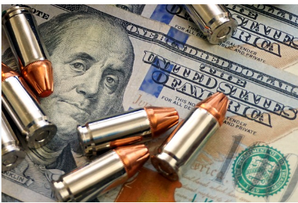
PROLIFERATION FINANCING (PF)
What is Proliferation Financing? The provision or movement of funds to support the development, acquisition, or spread of weapons of mass destruction (WMDs) such as nuclear, chemical, or biological weapons.
Key Regulatory Expectations (CBN):
Mandatory screening against sanctions lists (e.g., UN sanctions lists)
Freeze and report transactions linked to designated entities immediately
Ongoing monitoring of transactions for suspicious patterns
Prompt reporting to the Nigerian Financial Intelligence Unit
Common Red Flags:
Transactions involving sanctioned countries or entities
Payments for dual-use goods (items that can be used for both civilian and military purposes)
Complex trade transactions with unclear purpose
Use of intermediaries to disguise the true beneficiary
Your Responsibility:
Conduct proper KYC and sanctions screening
Pay attention to unusual trade-related transactions
Escalate suspicious activities immediately
Do NOT inform the customer (no tipping off)

Slide 8
DIFFERENCE BETWEEN ML, TF & PF
Topic | Money Laundering (ML) | Terrorist Financing (TF) | Proliferation Financing (PF)
Definition | Hiding the source of illegal funds | Providing funds for terrorist activities | Providing funds for weapons of mass destruction
Source of Funds | Always illegal (proceeds of crime) | Can be legal or illegal | Can be legal or illegal
Main Objective | Make dirty money look clean | Support terrorism | Support development/spread of WMDs
Focus of Detection | Unusual transactions, source of wealth | Links to terrorist groups or activities | Links to sanctioned countries/entities
Examples | Fraud proceeds sent through remittance | Donations sent to terrorist groups | Payments for restricted/dual-use goods
Regulatory Focus | AML controls | CFT controls | CPF (Counter-Proliferation Financing)

Slide 9
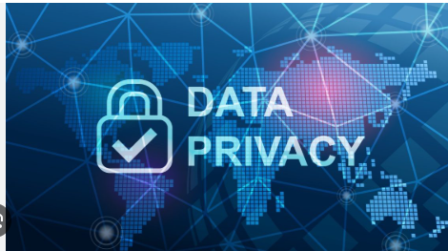
DATA PRIVACY & PROTECTION POLICY (Aligned with Nigeria Data Protection Act)
What is Data Privacy? Protecting customer and staff information from unauthorized access, misuse, or disclosure
What Data Do We Handle?
Personal details (name, phone number, address)
Identification data (BVN, NIN, ID documents)
Financial information (transaction details)
Key Principles to Follow:
Confidentiality: Do not share customer data unnecessarily
Purpose Limitation: Use data only for official/business reasons
Data Minimization: Access only what you need
Security: Keep systems, passwords, and devices secure
Staff Responsibilities:
Never disclose customer information to unauthorized persons
Do not use personal devices or emails for official data
Lock your system when not in use
Report any data breach immediately

Slide 10
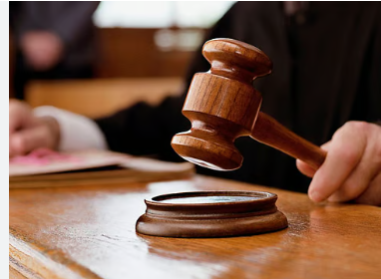
CONSEQUENCES & KEY TAKEAWAYS (In line with Central Bank of Nigeria & Nigeria Data Protection Act)
Penalties for Non-Compliance
Regulatory Sanctions: Heavy fines, licence restrictions or revocation
Criminal Liability: Possible imprisonment for ML/TF/PF offences
Company Impact: Financial loss and reputational damage
Data Breach Consequences: Fines, legal action, loss of customer trust
What This Means for You
Failure to follow AML/CFT or data privacy rules can affect both you and the company
Even negligence (not being careful) can lead to serious consequences
Key Takeaways
Know Your Customer (KYC) at all times
Watch for unusual or suspicious transactions
Never tip off customers
Protect customer data strictly
Report all concerns immediately

Slide 11

08
03

