Slide 1
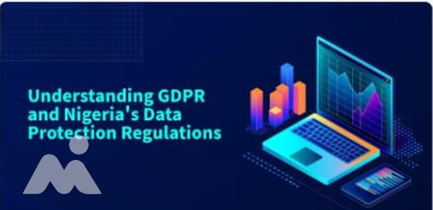

September 2025

Slide 2


INTRODUCTION
Data privacy is a global priority. Both GDPR (EU law) and NDPR (Nigeria’s regulation) ensure customer data is collected, processed, and stored responsibly.
NDPR (Nigeria Data Protection Regulation) governs the use and protection of personal data in Nigeria, while GDPR (General Data Protection Regulation) regulates the use and protection of personal data across European Union member states.
Relevance to Olive Monies: As an international money transfer operator, compliance builds customer trust and regulators as well as supports secure cross-border remittances

Slide 3




GDPR AND NDPR REGULATION AWARENESS TRAINING OBJECTIVES
01
Core principles of Data protection.
02
Personal data and what constitutes personal
03
data subject rights, data breach and reporting
04
Legal bases for processing Personal data
05
Data controller, data processor and employees responsibilities

Slide 4
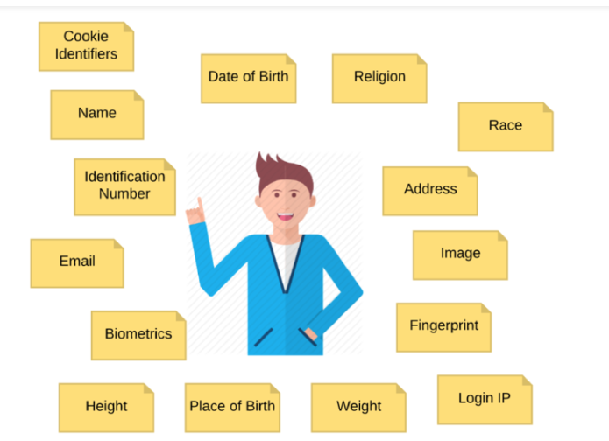
What is Personal Data?
Personal Data is any information that relates to an identified or identifiable individual, either directly (e.g., name, ID number) or indirectly (e.g., location data, online identifier).

Slide 5
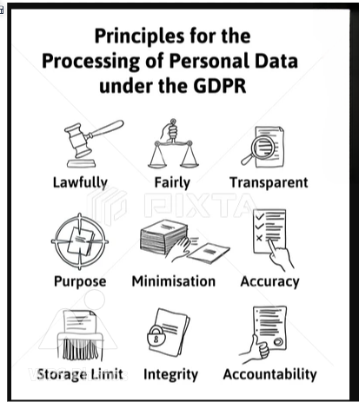

Slide 6
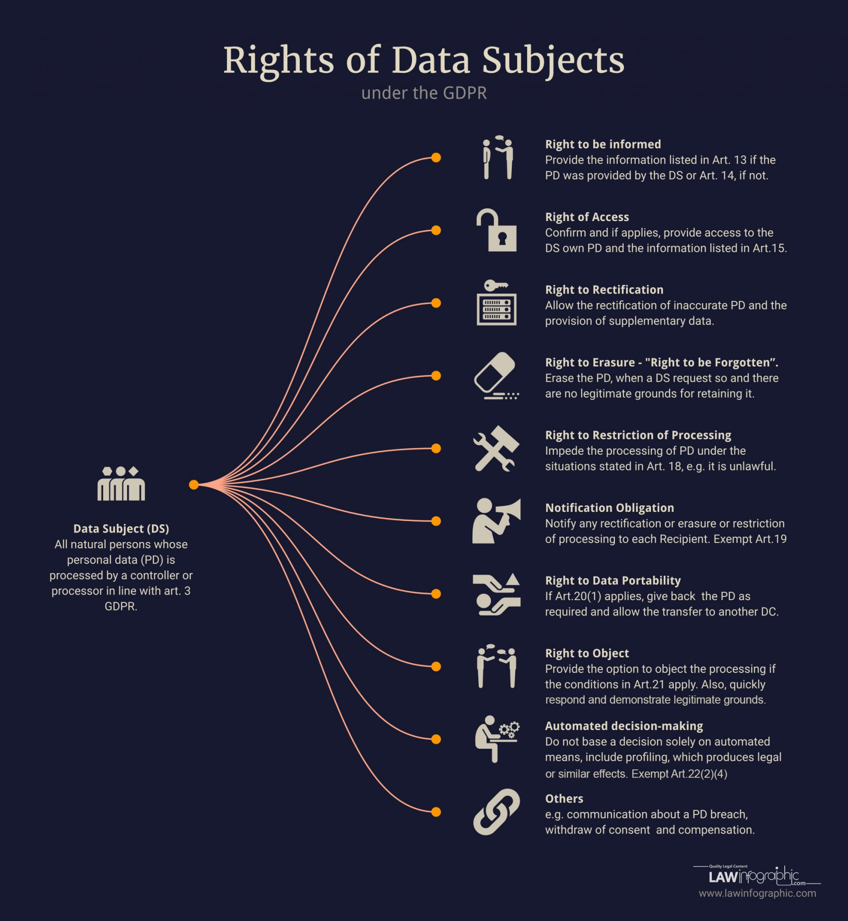

Slide 7
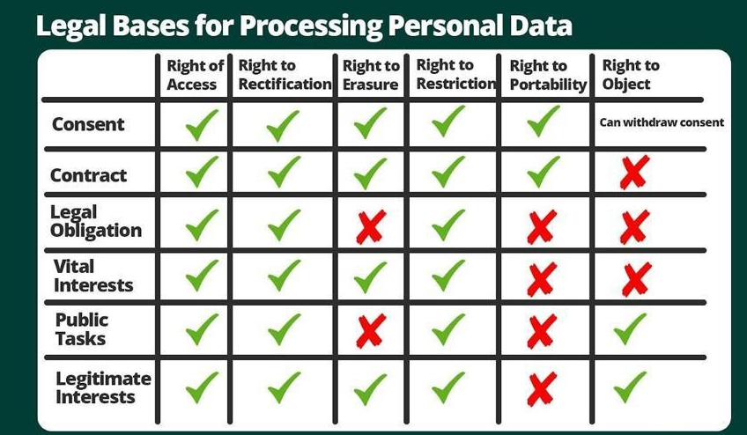

Slide 8
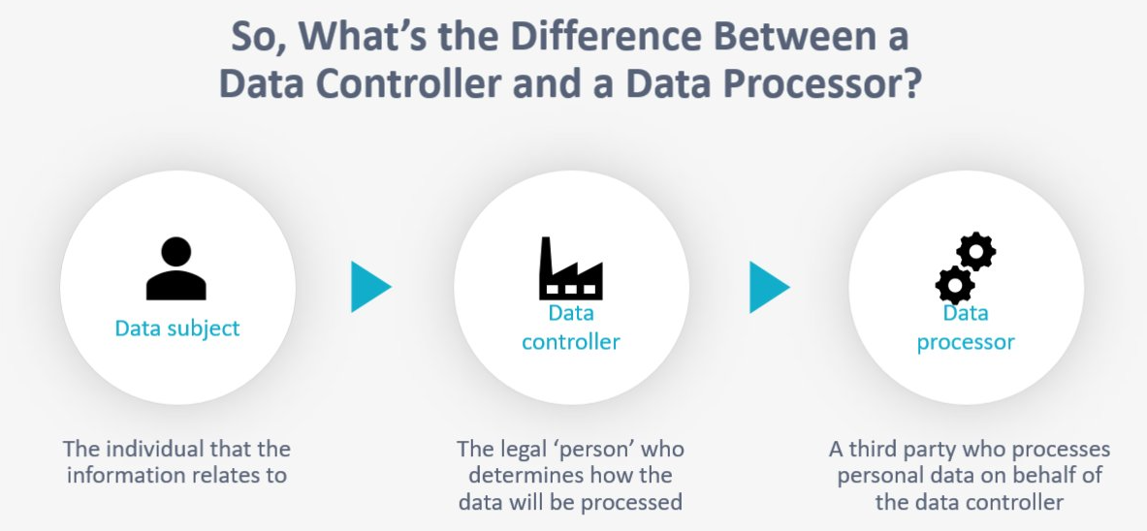

Slide 9
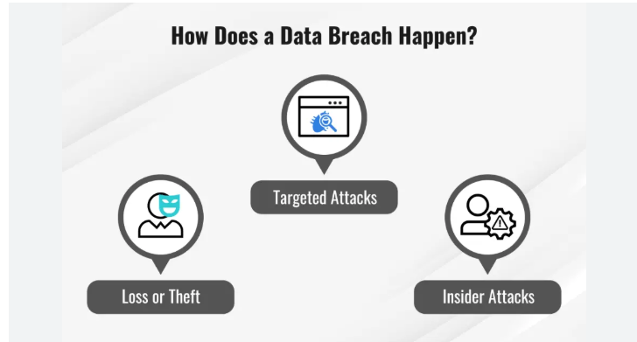
A data breach occurs when sensitive, confidential, or protected information is accessed, disclosed, or used without authorization.
Examples:
An employee accidentally emails customer banking details to the wrong recipient.
Hackers gain unauthorized access to a company’s database and steal customer personal information.

Slide 10
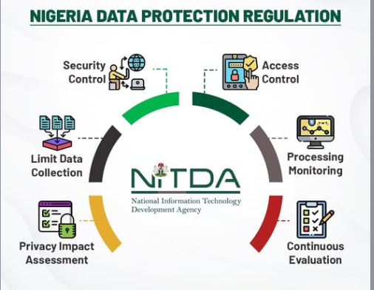
GDPR/NDPR TOOLS FOR DATA BREACH PREVENTION

Slide 11
Major Data Privacy Breaches: Multichoice and Fidelity Bank Fined Heavily
Multichoice:
The Nigeria Data Protection Commission (NDPC) fined Multichoice ₦766,242,500 for illegally transferring Nigerians’ personal data across borders and adopting intrusive, unfair, and disproportionate data processing practices, in violation of the Nigeria Data Protection Act (NDPA).
Despite being ordered to implement remedial steps, NDPC found the company’s response unsatisfactory and placed all Multichoice data-collection outlets under heightened scrutiny, warning of further severe penalties for continued non-compliance.
Fidelity Bank:
In a separate case, Fidelity Bank Plc was fined ₦555,800,000 by the NDPC in August 2024 for processing customers’ personal data without informed consent — including misuse of cookies and mobile banking tools.
The fine, representing 0.1% of the bank’s 2023 gross revenue, was increased due to the bank’s lack of cooperation and “arrogant disposition” during the investigation. Fidelity Bank disputed the findings, insisting no breach occurred.

Slide 12

Employees’ Responsibilities in Handling Personal Data
Collect only necessary data required for transactions and ensure customers are informed about its purpose.
Protect customer data by keeping it secure from unauthorized access, disclosure, or misuse.
Use personal data strictly for transactions and compliance purposes.
Comply with internal policies and regulations (e.g., GDPR, NDPR, AML/CFT) and participate in regular data protection training.
Respect customer rights by promptly forwarding requests for access, correction, or deletion of data to the compliance or Data Protection Officer.
Report any data breaches or suspicious activity immediately to the appropriate authority within the company.

Slide 13
CONCLUSION
At Olive Monies, protecting personal data is not just about compliance—it is about trust. By handling customer information lawfully, securely, and transparently, we safeguard our customers, meet regulatory expectations, and strengthen our reputation as a reliable international money transfer service.

Slide 14
Thank You

